Slide 1


DETECTING PHISHING WEBSITE AND SPAM CONTENT USING MACHINE LEARNING
(A MAIN PROJECT SECOND REVIEW)
Presented by
Anthoni Thomas R (732119205005)
Karthikeyan D (732119205022)
Pon Pandian P (732119205038)
Sekar S (732119205047)
Project Guide
Mr. N.Prasad M.E.,
Assistant Professor,
Department of Information Technology

Slide 2
ABSTRACT
Now a days we get the message which contains “Content” and “Link”.
With the rapid growth of internet users, people are using them for illegel and unethical conducts, phishing and fraud.
This project will identify those Spam Messages and Phishing URL’s on the messages by using the techniques of Machine Learning.
Apply all the Machine Learning algorithms on our datasets and best algorithm is selected for our project, which having the best precision and accuracy.

Slide 3
INTRODUCTION
Phishing is a type of cyber attack that uses deceptive emails, websites, or text messages to trick users into providing sensitive informations.
Web Phishing is a form of cybercrime where criminals attempt to steal sensitive information such as login credentials, credit card details and personal data by disgusing themselves as a legitimate entity through a fake website or e-mail.
Web Phishing is a significiant threat to Individuals, Businesses and Organizations, it can result in identity theft, financial losses and reputational damage.
Using Machine Learning Algorithms, it is possible to detect phishing URL’s and text by analyzing the content of the messages, URL’s and attachments.

Slide 4

OBJECTIVE
To develop a system that can automatically identify and classify websites and content that are designed to trick users into providing sensitive information, downloading malware, or taking other harmful actions.
This can help to reduce the risk of users falling victim to phishing attacks and protect them from receiving unwanted or harmful messages.

Slide 5
LITERATURE SURVEY
1. Author : Khatod, V., & Jain, P. (2020)
Overview : This paper proposes a hybrid approach for detecting phishing websites using feature extraction and machine learning.
Model : Random Forest
Accuracy : 98.3%
2. Author : Mani et al (2018)
Overview : The ensemble strategy aided in obtaining a higher accuracy score.
Model : Random Forest, Naive Bayes and SVM
Accuracy : 87.68%

Slide 6
LITERATURE SURVEY
3. Author : Kumar et al (2018)
Overview : For effective spam identification, uses both univariate and multivariate distribution across user ratings.
Model : Random Forest, Navie Bayes, SVM, K-Nearest Neighbor and Decision tree
Accuracy : 76.0%
4. Author : Watcharenwong, Saikaew (2017)
Overview : Social features like comments etc., are combined with textual features yields better results.
Model : Random Forest
Accuracy : 91.3%

Slide 7
LITERATURE SURVEY
5. Author : Dewan, Kumaraguru (2015)
Overview : Automatic identification of spam text is done with 42 features using Machine Learning Techniques
Model : Random Forest
Accuracy : 86.9%
6. Author : Mohammed et al (2013)
Overview : Instead of using spam trigger words, Which may fail, a lexicon-based approach is used to filter the data.
Model : Naive Bayes, SVM, K-Nearest Neighbor and Decision tree
Accuracy : 85.96%

Slide 8
EXISTING SYSTEM
Existing System is based on the Support Vector Machine and Random Forest Algorithm.
Then it was using the Support Vector Machine for its accuracy which is best.
Correct classification ratio, F1-score, Matthew’s correlation, Classification ratio and False negative ratio and False alarm ratio are used to evaluate the performance of different classifiers.
Feature
Extraction
Random
Forest
URL
Preprocessing
Predicition
Result
Support Vector
Machine
Performance

Slide 9
PROPOSED SYSTEM
In this project, we are using Kneighbors Classifier and SVM algorithm. When we are using the Kneighbors Classifier algorithm then its accuracy is best.
In this project, we have provided URL and Phishing website data as input.
Then we detect the output whether the provided input is a Phishing website or Not.
And also we detect the output whether the text data is Spam or Not.

Slide 10
SYSTEM SPECIFICATION
HARDWARE SPECIFICATION :
Processor Type
Speed
RAM
Hard disk
Keyboard
Mouse
SOFTWARE SPECIFICATION :
Operating System
:
:
Intelcore i3
3.40GHZ
:
Min 4GB
:
:
500 GB
101/102 Standard Keys
:
Optical Mouse
:
Windows 10
Tool
Language
:
:
Visual Studio Code, Jupyter, Flask, Bootstrap and IBM Cloud
Python, MySQL, HTML and CSS

Slide 11
MODULES
User Registration and Login
Spam Text Detection
Phishing URL Detection
Chat Bot

Slide 12
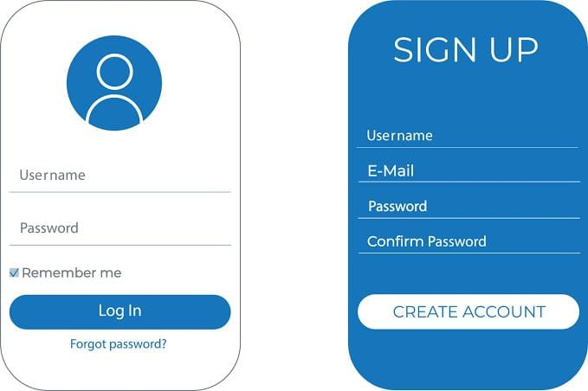
MODULES SPECIFICATION
1) USER REGISTRATION AND LOGIN :
In this module, the user authenticate the website by register and login it.
User Registration is required to create new login.
In the registration the user have to give username, E-mail id and password.
These details are stored into the database.
User has to Login after Registering.

Slide 13
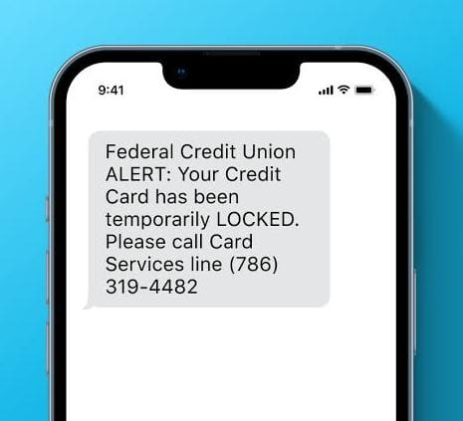
MODULES SPECIFICATION
2) SPAM TEXT DETECTION :
In this module, the user can click the Text detection button for to detect the Spam text or Spam content.
After clicking the Button , The user can enter the website content or any other message content in the empty dialog box.
That message content is accepted to detect as Spam content or Normal sentence.

Slide 14

MODULES SPECIFICATION
3) PHISHING URL DETECTION :
In this module, the user can click the URL detection button for to detect the Phishing website.
After clicking the Button , The user can enter the website URL or message URL in the empty dialog box.
That URL is taken to detect Whether it is a phishing website or not.

Slide 15
FLOW DIAGRAM
DATASET COLLECTION
OF THE
PHISHING WEBSITE
FEATURE EXTRACTION
FEATURE SELECTION
MODEL EVALUATION
MODEL TRAINING AND TESTING
MACHINE LEARNING
MODEL
IMPLEMENTATION OF PHISHING WEBSITE DETECTION

Slide 16
REFERENCES
Almeida, T. A., Gómez Hidalgo, J. M., & Yamakami, A. (2011). Contributions to the study of SMS spam filtering: New collection and results. Journal of Machine Learning Research.
Alzahrani, A., & Yoo, P. D. (2021). Deep learning-based phishing detection techniques: A comprehensive review. Journal of Information Processing Systems.
Bilenko, M., & Mooney, R. J. (2003). Adaptive duplicate detection using learnable string similarity measures. In Proceedings of the 6th International Conference on Discovery Science.
Guzella, T. S., & Caminhas, W. M. (2009). A review of machine learning approaches to spam filtering. Expert Systems with Applications.
Kumar, A., Kant, K., & Gupta, B. B. (2018). A machine learning approach for phishing detection using novel features. Expert Systems with Applications.

Slide 17
REFERENCES
6. Li, Y., Li, J., Li, K., & Li, J. (2019). A machine learning-based approach for phishing websites detection. Journal of Intelligent & Fuzzy Systems.
Mani, G. K., Reddy, B. K., & Kumar, G. P. (2018). Hybrid approach for detecting phishing websites using machine learning and rule-based techniques. International Journal of Computer Applications.
Schneider, J., Martinez-Romo, J., & Almeida, T. A. (2017). Toward effective SMS spam filtering: A review of state-of-the-art techniques and trends. IEEE Transactions on Systems, Man and Cybernetics Systems.
Zhang, W., Zhang, H., Hu, B., & Cheng, X. (2017). Deep learning for detecting SMS spam. In 2017 IEEE 14th International Conference on Networking, Sensing and Control (ICNSC).
Zhu, X., & Yao, H. (2019). A phishing detection method based on SVM optimized by particle swarm optimization algorithm. Journal of Ambient Intelligence and Humanized Computing.

Slide 18


